Slide 1
How to command an AV at a position in SUMO
Wushuang Bai

Slide 2
The purpose of this presentation is to show how to command an AV at a position in SUMO.

Slide 3
A test was performed with the goal to command an AV at a position in SUMO.
Input:
Commanded position in (x, y) meters
Output:
Actual position in (x, y) meters
Script used:
script_traciTest_CommandVehPosition.py
Data files used:
hello.sumocfg - this runs the simulation
hello.net.xml - this describes SUMO road network
hello.rou.xml - this describes simulation route
hello.settings.xml - this describes simulation settings such as simulation delay

Slide 4
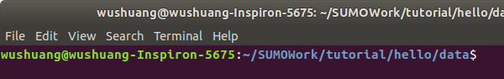
Step 1. Navigate to the folder of data files and script, open a terminal. Basically, using python API, the script calls SUMO, takes user's input of commanded position in x and y, and run the simulation.

Slide 5
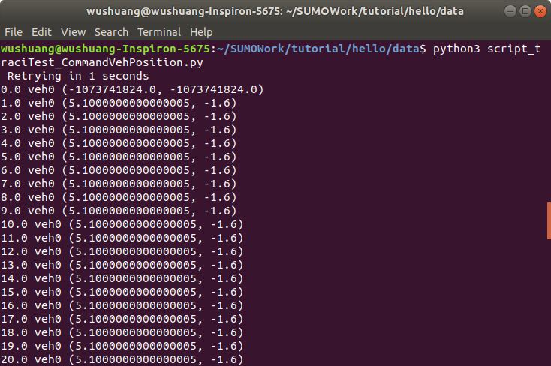
Step 2. Run the script by running command "python3 script_traciTest_CommandVehPosition.py"

Slide 6
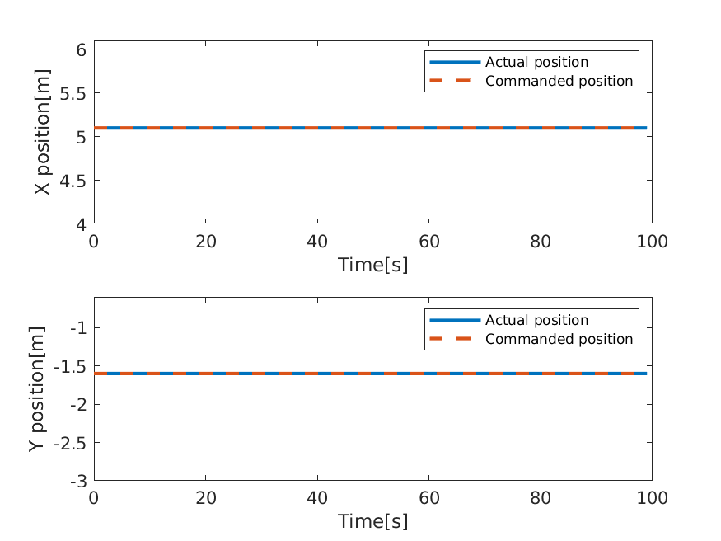
Step 3. Investigating the results. In this example, commanded position is (5.1, -1.6) in meters. It shows that the actual position matches the commanded position.For how to export the results, please see the document "How to export SUMO simulation results.pptx"

Slide 7
Files used in this document can be found:
Data files can be found: https://github.com/ivsg-psu/TrafficSimulators_GettingStartedWithDifferrentSimulators_GettingStartedWithSUMO/tree/main/Data/HelloSUMO
Script can be found: https://github.com/ivsg-psu/TrafficSimulators_GettingStartedWithDifferrentSimulators_GettingStartedWithSUMO/tree/main/Code
For more information, please see:
https://sumo.dlr.de/docs/TraCI.html
https://sumo.dlr.de/docs/TraCI/Change_Vehicle_State.html

